Slide 1
GRATER: An Approximation Workflow for Exploiting Data-Level Parallelism in FPGA Acceleration
By: Atieh Lotfi, Abbas Rahimi, Amir Yazdanbakhsh, Hadi Esmaeilzadeh, Rajesh K. Gupta
Presented By: Williams Paek

Slide 2
Author Information
Atieh Lotfi : Received PHD in computer science from University of California. Additional papers are linked here: http://cseweb.ucsd.edu/~alotfi/
Abbas Rahimi: Research Staff Member, IBM Research-Zurich, Additional Papers can be found at https://scholar.google.com/citations?user=yx0pEmYAAAAJ&hl=en
Amir Yazdanbakhsh: Research Scientist at Google Brain / Georgia Institute of Technology. Additional papers can be found at: https://scholar.google.com/citations?user=Vdu_sqwAAAAJ&hl=en
Hadi Esmaeilzadeh: Assistant professor at GIT and is part of ACT laboratory. Papers and research can be found at: https://www.cc.gatech.edu/~Hadi.Esmaeilzadeh/
Rajesh K. Gupta: Professor and holder of QUALCOMM endowed chair in embedded Microsystems at UCSD. Additional papers can be found here: https://scholar.google.com/citations?user=I1w51gUAAAAJ&hl=en
Notes:
Scalability of the design improves since IP can be replaced easily

Slide 3
Additional Background Readings
Genetic Programming: http://geneticprogramming.com/tutorial/#:~:text=Genetic%20programming%20is%20a%20domain,of%20naturally%20occurring%20genetic%20operations.
OpenCL Kernels:
https://en.wikipedia.org/wiki/OpenCL#Open_Source_implementations

Slide 4
Answers To What We Are Looking For
Type of approximation? Data bit manipulation, specifically reducing the size
Approximation strategy? Smaller kernels => more kernels in an area
Method? Genetic programming
What is being approximated? Data and operation precision in order to decrease kernel size
Determination of what to approximate? Genetic algorithm to find a subset of safe-to-approximate
Acceptable Approximation? Application specific/ User Set
Application uses? Graphics, Multimedia, Web Search, and Data Analytics
Notes:
Packets, frames, flits, etc

Slide 5
The Problem
Improving Parallelism and Computational Throughput utilizing the inherent pipelining properties of FPGAs
Notes:
Packets, frames, flits, etc

Slide 6
Similar Solutions
SNNAP
ASIC specific
Custom data types
Not very reconfigurable

Slide 7
The Solution
Grater Framework
Software
Two part solution
OpenCL kernels
Genetic optimization programming
Notes:
Packets, frames, flits, etc

Slide 8
OpenCL Kernels
OpenCL is a framework intended to run programs that use CPUs, GPUs, DPSs, FPGAs, and other processors/hardware accelerators.
Mainly used to implement a standard interface for parallel computing and data/task based parallelism.

Slide 9
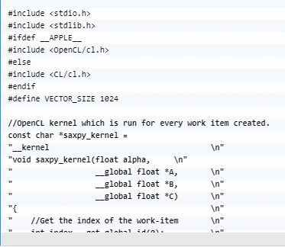
Example of OpenCL

Slide 10
Translation to FPGA’s
Can use source to source compilers to transform OpenCL kernels
These kernels are then altered to utilize less space and resources on the FPGA
FPGA’s can then implement multiple copies of kernel pipelines which can linearly improve performance

Slide 11
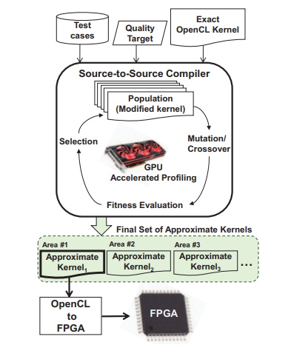
Translation to FPGA’s

Slide 12
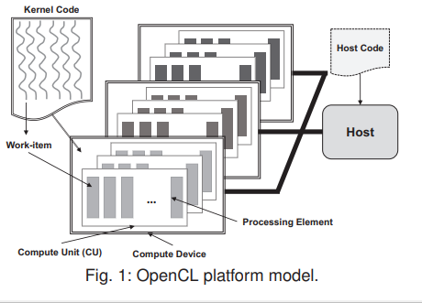
GRATER: APPROXIMATION DESIGN WORKFLOW
Transformation algorithm detects kernel code that can be simplified while maintaining the desired quality of data
Uses three parameters
an exact OpenCL kernel
a set of input test cases
a metric for measuring the quality-of-result target
Notes:
Assume 32 bits, MS

Slide 13
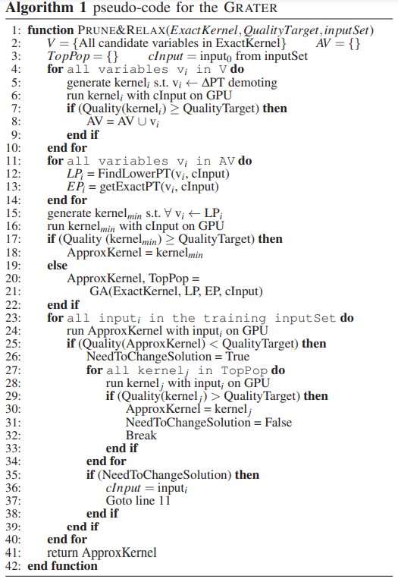
GRATER: APPROXIMATION DESIGN WORKFLOW
Precision of functions and data used to decide approximations
Four levels of complexity
Float, int, short, char
Higher the complexity, the more resources and space are used
Pruning
Simply put, each variable in a function is set to the lowest it can possibly be while maintaining quality
Notes:
Assume 32 bits, MS

Slide 14
GRATER: APPROXIMATION DESIGN WORKFLOW - Part 2: Genetic Algorithm
After pruning, sample space of possible choices is extremely large
Genetic Algorithm used to create appropriate solution
Notes:
Assume 32 bits, MS

Slide 15
Genetic Programming/Algorithms
Randomly create an initial population
Iteratively perform the following sub-steps (called a generation) on the population until the termination criterion is satisfied
Final solution is chosen after criteria is met

Slide 16
Experiments
3 application tests
Image processing (recursive gaussian, sobel)
Signal processing (convolution, dct)
Physical simulation (n-body)

Slide 17
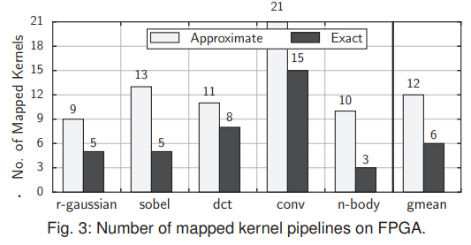
Experiments
Average of 14%–25% for different FPGA resources using the transformed approximate kernel instead of the exact one

Slide 18
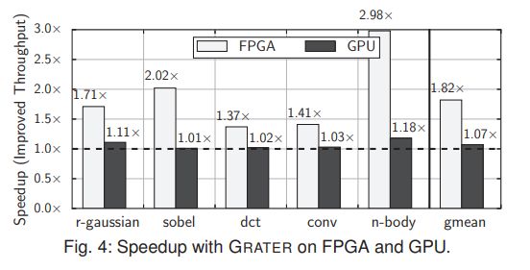
Experiments
Clock frequency changed from 209 MHz for the exact kernel to 187 MHz for the approximate kernel (n-body test)
Approximate nbody kernel reaches to 2.98× higher throughput compared to the exact kernel

Slide 19
Experiments Results

Slide 20
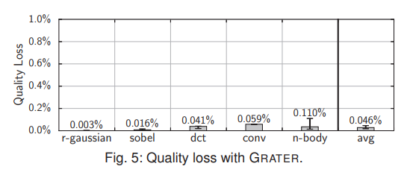
Experiments Results

Slide 21
Questions
Question 1
What is an OpenCL kernel?
A) Functions executed on an OpenCL device
B) The main processing unit
C) A source to source compiler
D) A FPGA implementation of an operating system
Answer: A

Slide 22
Questions
Question 2
What are the three parameters for the GRATER transformation algorithm?
A) An exact OpenCL kernel,
B) A set of input test cases
C) A metric for measuring the quality-of-result target
D) Machine code source
E) A FPGA device
Answer: A, B, C

Slide 23
Questions
Question 3
What are the two operators used to produce new chromosomes in the genetic algorithm?
A) Crossover
B) Mutation
C) Punnett Square
D) Inbreeding
Answer: A and B

Slide 24
Further Discussion
Possible cascading of this design due to genetic algorithm being very resource and time cost heavy
Other ways to improve a genetic algorithm

